Slide 1
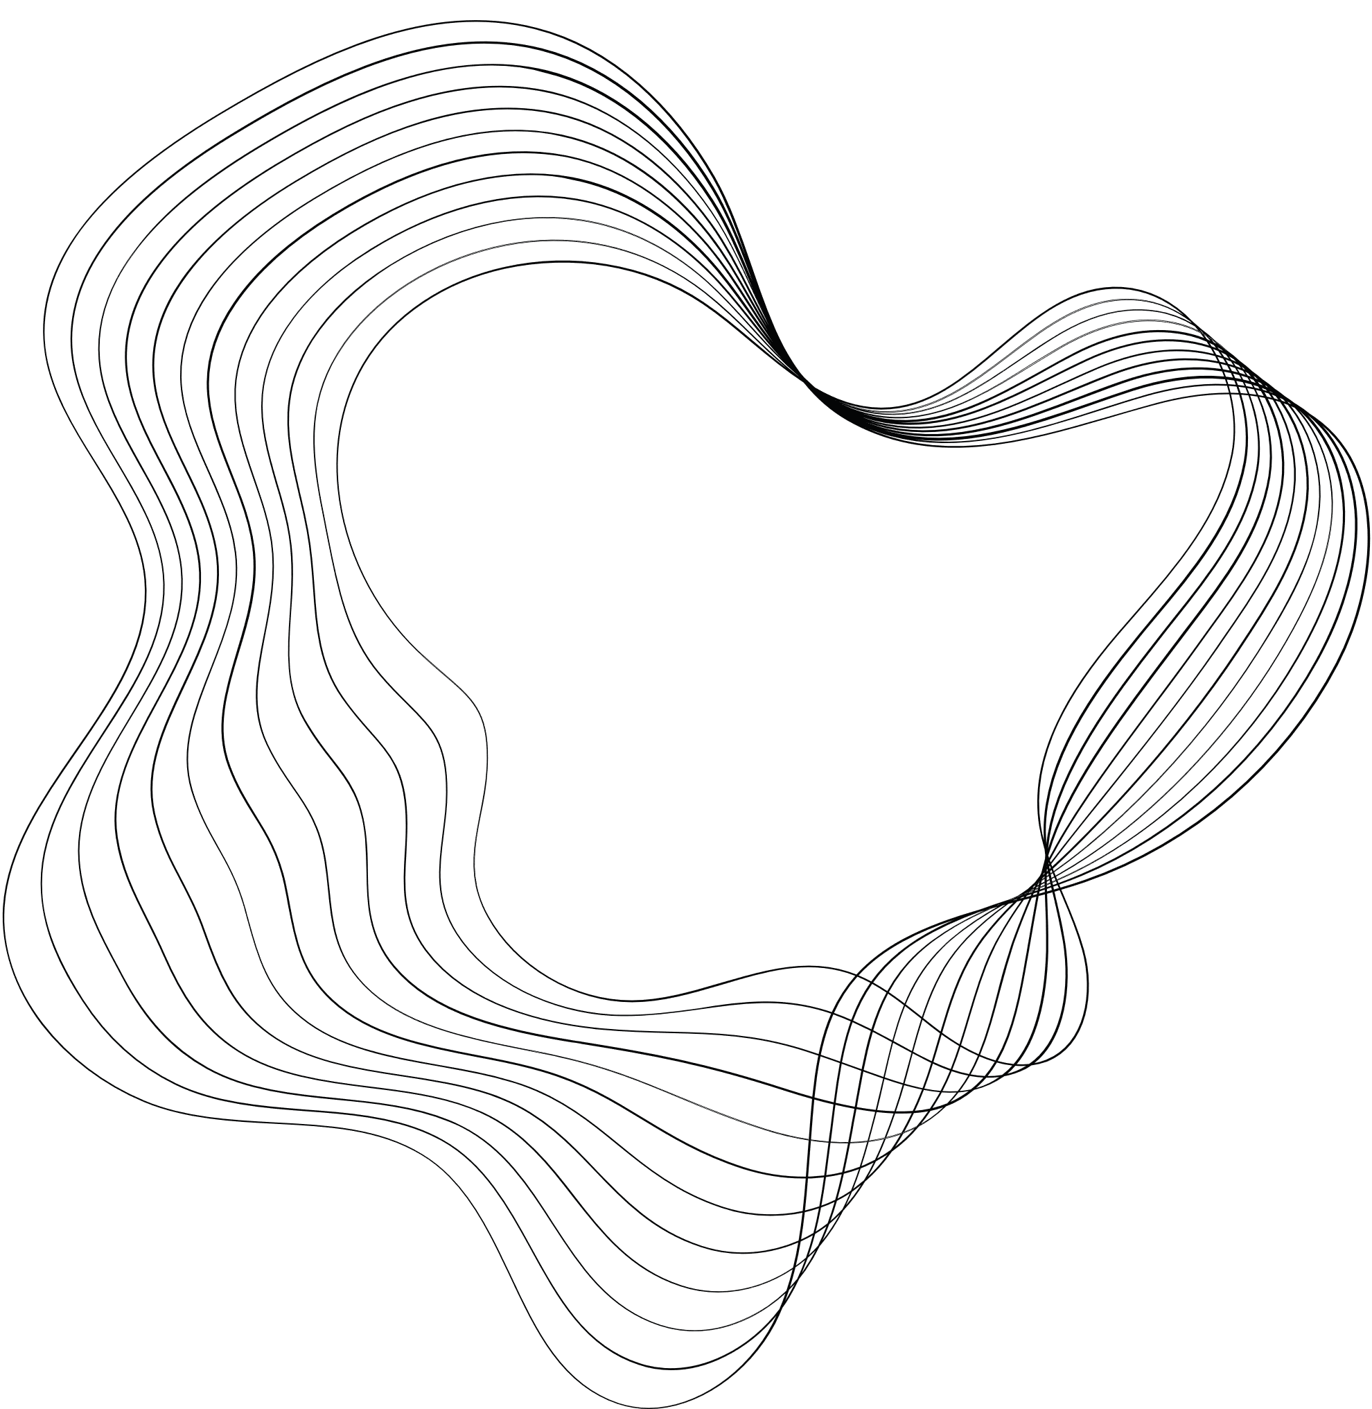

AUR FINAL
PROJECT

Slide 2

CONTENT
01
OUR TEAM
02
MECHANICAL
03
HARDWARE
04
SOFTWARE
4.1 CONSOLE
4.2 EMBEDDED
4.3 MOTION & LOCALIZATION

Slide 3
OUR TEAM
Mechanical:
Aly Mohie
Hardware:
Amr Sokkar
Mohammed Nabil
Software:
Habiba Abdel Hameed
Ahmed El-Masry
Ahmed Sameh
Ahmad Hossam
Youssef Samy

Slide 4
Mechanical
Motors: DC Motor GA25-370
Mass: 6 kg
Incline: θ = 0 (flat playground)
Acceleration: 0.5 m/s²
Efficiency:70%
Output Torque: ≈ 0.9 kg.cm
RPM: 100
Why GA25-370?
High torque for effective acceleration
Ideal for small spaces
Prioritizing acceleration over top speed
Equipped with encoders for precise localization
Materials & Dimensions:
Chassis Material: Wood
Advantages:
Light
Easier to Shape
Budget-Friendly
Perfect for quick modifications
Laser-cut to precise dimensions of 400*226mm
Servo Selection:
MG945: 10.5 kg.cm torque → for raising and lowering the arm)
SG5010: 5.5 kg.cm torque → for opening and closing the gripper
Wheels:
Robot Wheel 65mm → high grip rubber

Slide 5
Electrical
L293D Motor Driver IC :
Why Use L293D?
Built-in durability and protection make it a robust choice for motor control!
Key Features:
Dual H-bridge: Controls two motors independently
Operating Voltage: Logic voltage of 4.5V to 7V (Vcc1); motor voltage up to 36V (Vcc2)
Current Handling: Up to 600mA continuous current per channel (1.2A peak)
Thermal Shutdown: Prevents overheating
Internal Protection Diodes: Safeguards against back-EMF from motors
Bidirectional Control: Enables forward and reverse motion
Enable Pins: Manage motor states (enabled/disabled)

Slide 6
Software
4.1 Console:
UI Components:
Video Feed Display: Shows live footage, with buttons to select different vision algorithms.
Dynamic Box List: Lists all detected boxes and their coordinates in real time.
Dynamic Map: Continuously updates with the robot's current position.
Navigation & Control System:
We use the Gamepad API, standard in all major web browsers, to process gamepad inputs with a game-loop-like algorithm polling every 15 ms.
Key Features:
Input Precedence: The algorithm prioritizes inputs to prevent wheel differential damage.
Forward/Backward Motion: Calculated by subtracting the L2 value from the R2 value
Right Analog Stick Calibration: Before use, a full rotation calibrates the stick via the controller's firmware, with an error margin of 0.1 accounted for in any direction. Vertical directions and irrelevant inputs are ignored.

Slide 7
Software
4.1 Console:
Computer Vision:
Detects and decodes QR codes on every box
Assigns a unique box number to each code
Assists the navigator in tracking and managing box destinations efficiently
Communication:
Host | Component | Connects to
Mobile | IMU | Console w/ HTTP GET
Mobile | Camera | Console w/ HTTP
Console | MQTT Broker | ESP-32WR00M
Console-Backend | Flask & Socket IO | Frontend
The Algorithms made available:
Library | Strength | Weakness
pyzbar | Extremely Efficient | Angled Codes
Cv2- builtin | Angled Codes | Less Efficient
qreader | Deepest Detection | Least Efficient

Slide 8
Software
4.2 Embedded:
Goals for ESP-32WROOM Programming:
Receive motion commands from the console and translate them for motor control
Convert arm and gripper commands into servo-friendly instructions
Send encoder data to the console for localization
Use RTOS to separate receiving, sending, and callbacks into different tasks

Slide 9
Software
4.3 Motion & Localization:
Console and Motion Goals:
Get Gamepad commands from console
Map values from 0 → 1 to 0 → 255
Prepare values for differential steering
(e.g., for right rotation at speed x, → add x speed to the right wheel and -x speed to the left wheel)
Receive encoder readings from the ESP-32WROOM and IMU data from the mobile phone
Apply a Kalman filter for accurate localization

Slide 10
Software
4.3 Motion & Localization:
Goals for Localization:
Receive data from Wheel Encoders & Receive IMU data from Mobile Phone’s Sensors
Apply Extended Kalman Filter to get more accurate coordinates for Robot’s Position
Extended Kalman Filter:
1. Initialization Phase:
The FusionEKF class is created to manage state estimation using an Extended Kalman Filter (EKF).
When process_measurement is called for the first time ,The state vector self.ekf_.x is initialized to zeros, representing [px, py, vx, vy, yaw, yaw_rate].
The previous_timestamp is set to the current timestamp.
The is_initialized flag is set to True to prevent reinitialization.

Slide 11
Software
4.3 Motion & Localization:
Extended Kalman Filter:
2. Prediction Step:
For Subsequent sensor data:
The time difference dt between the current and previous timestamps is calculated
The State Transition matrix F is updated to incorporate the time effect on position
The EKF predicts the next state using this updated matrix and a process noise covariance
3.Measurement Update:
The filter updates the state using measurements from different sensors
IMU Measurements:
Accelerometer and gyroscope data update the state for yaw and velocity
Wheel Encoder Measurements:
Distance data from left and right encoders calculate changes in position
The EKF updates the state vector with these values.

